Slide 1
NAVIGATION SYSTEM FOR BLIND USING HAPTIC FEEDBACK VIBRATION
Shadab Karnachi 2gi19is048
Akhila Kulkarni 2gi19is005
Mahadvesh patil 2gi19is022
Prof. Rakesh Kadkol
Kls Gogte institute of technology, Belagavi

Slide 2
- INTRODUCTION
-There are nearly 250 million people who suffer from blindness across the world. Either some have birth defect or suffer from acquired old age loss of vision. Every human being needs mobility and locomotion, that needs visual stimuli to locate the pathways and the navigate to the destination.
- The question was, How can we create a more efficient, new design that is effective, simplistic and less expensive, that can out perform existing technologies? The solution was to create a Head based Band with Haptic Feedback based technology that uses vibrations and our sense of touch to create more stronger interaction in responding to the user.
- Our Project is a Head-Band Navigator that uses ultrasonic sensors to detect objects and calculate a pathway and instructs the user with vibrations on his head directly with haptic technology(VIBRATIONS).
- It is far more better, simplistic, more effective and far cheaper compared to other existing technologies in the market.
- We were able to construct this device within 7,000 rupees.

Slide 3
- OBJECTIVES
- Design and Build a Hand-Band device consisting of designed hardware capable of wearing on the head.
Design and develop a C++ program for the device with appropriate algorithms, protocols, libraries and produce an efficient code.
Study the effects of head navigation and haptic feedback technology on blind people and its effectiveness and efficiency.

Slide 4
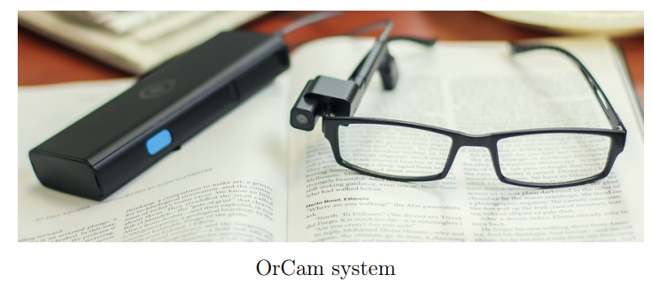
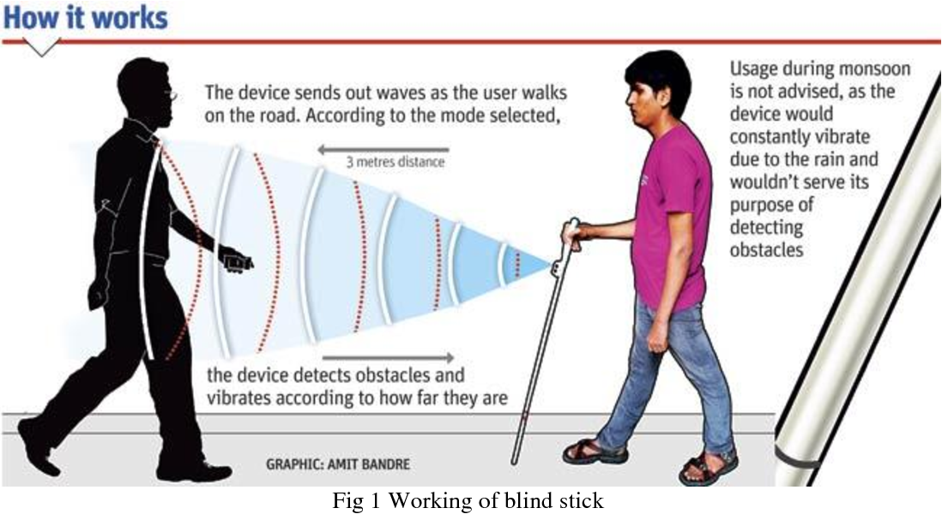
- Existing Technology
- SMART STICKS are simple navigation stick technology that uses digital sensors and actuators on a classic wooden stick and enhances its sensing and effectivesness using audio or other form of responses.
- OrCam systems uses wearable camera devices that use object detection using Artificial intelligence and informs the user by audio, however, the artificial intelligence requirement of high hardware and processing power make them limited

Slide 5
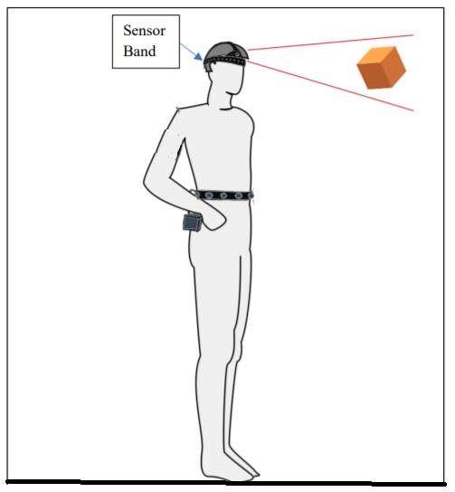
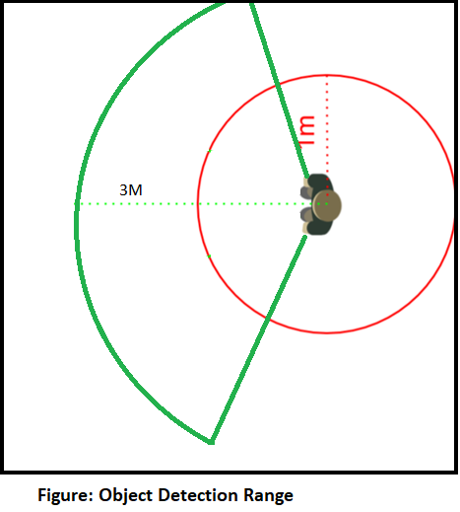
- DESIGN: OUR HEADBAND
Fig 1. Design of the Head Band
5
1
Sensor1
4
Sensor4
2
3
Sensor2
Sensor3
Vibration Motors -Haptic Feedback

Slide 6
- DESIGN ELEMENTS
Ultrasonic sensor: Ultra sonic sensor suit the best for this project as it can detect any object that lies on the ground, situated a distance of certain meters from the user. The sensor will then detect the presence of any object that lies within that meters by detecting the reflected sound beam.
Microcontroller chip: Both the sensors and the vibration interface would be controlled through microcontroller. One of the biggest microcontroller names in the market is the Arduino family, with over 20 different board models. To meet the design spec of being lightweight and portable, the Arduino Mini Pro was chosen.
Vibrating motor: To determine how the device would alert the user the proximity of objects first, audio signals were considered. However, an audio signal would be difficult to hear in a loud area and cause confusion to the user. A good alternative to audio signals would be a vibrating interface. The vibration interface would indicate to the user the proximity of an object with different vibration intensities and speeds.

Slide 7
- THE POWER OF VIBRATIONS
-After our sense of sight, the second most powerful sense of human is touch: Vibrations. Touch is fundamental to everything we think and feel, how we communicate and bond. touch can have powerful psychological effects on both the giver and the recipient. it conveys a lot of unsaid information.
- Vibrations if a form of touch that can convey information in a very effective and quick responsive way. It Requires least processing time compared to audio, smell or any other sensory.
- Our main objective of this project was to demonstrate the power of vibrations and how powerful and effective it is in conveying information.
- The vibrations produced in the project are multi-frequency multi pattern, that is calculated by an algorithm, which tells faster and more intense vibrations if the object is very close. This project hopes to produce quick detections and aims to produce more RESPONSE TIME than other navigational assistance.

Slide 8
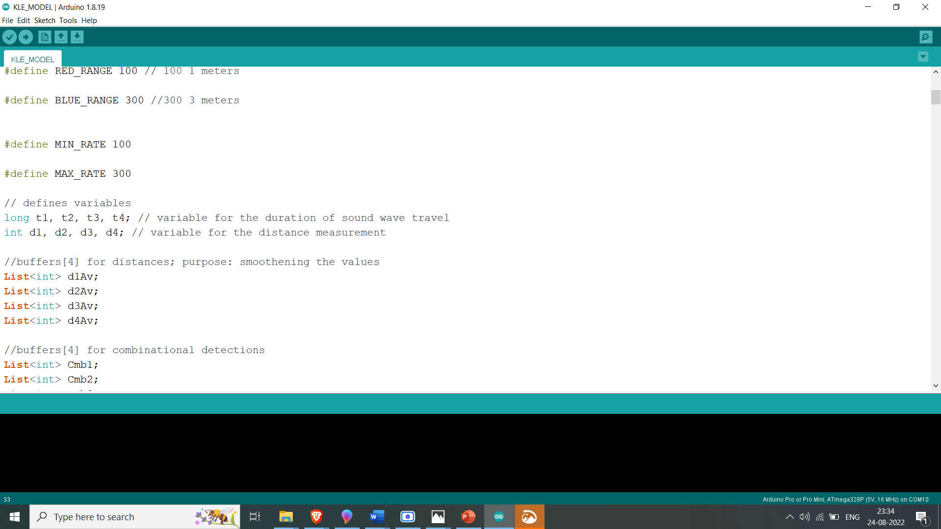

- CODE & SOFTWARE
- We used Arduino Hardware and Software as a standard development procedure that utilized engineering and Diploma Learning Tools.
Arduino IDE is the software that is used to develop the source code of the microcontroller. It is chosen because it is widely used and the language is easy to understand. It is compatible for various kinds of microchip development system tools. A cable & driver is used for connecting Arduino software to the system.
- Arduino IDE uses a simplified version of C++, making it easier to learn to program. Finally, Arduino provides a standard form factor that breaks out the functions of the micro-controller into a more accessible package.

Slide 9
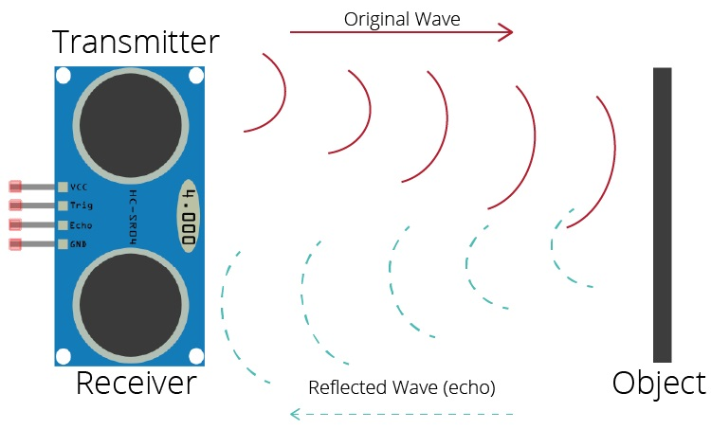
OUR ALGORITHM
WE DIVIDE THE AREA INTO FOUR PARTS WITH FOUR SENSORS. EACH SENSOR DETECTING OBJECTS IN ITS RANGE.
THEN WE EMPLOY SPECIAL COMBINATIONAL ALGORITHM TO CLASSIFY THE OBJECT AND CALCULATE THE RATE OF THE VIBRATION AND WHICH MOTORS TO VIBRATE.
ALGORITHM:
STEP 1: GATHER RAW DISTANCES DATA FROM SENSOR
STEP 2: MATHEMATICAL CALCULATION & DETECTION WTH ALGORITHMS(PROCESSOR)
STEP3: CLASSIFICATION OF PATHWAY AND CHOOSING RIGHT VIBRATION PATTERN
STEP4: EXECUTION OF VIBRATIONS IN MOTORS AND REPEATING THE STEPS
STEP 5: LOOP: REPEAT FROM STEP 1
3
2
4
1

Slide 10
- ALGORITHM II: COMBINATIONAL DETECTION
Combinational detection algorithm Aims to detect if the object covering 2 sensors is a single object or 2 different objects
Algorithm(Sensor1, Sensor2, Sensor3, Sensor4){
Classification condition:
//combinational Detection
If object in both sensor1 & 2
If object in both sensor 2& 3
If object in both sensor3 & 4
//Individual Detection
If object in sensor1
If object in sensor2
If object in sensor3
If object in sensor4
}
2
3
4
1

Slide 11
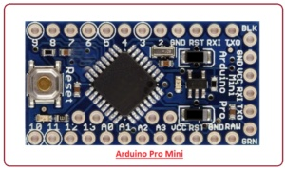
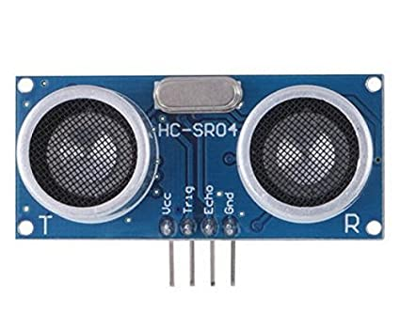
HARDWARE: Components and Parts
-ARDUINO PRO MINI: Arduino Pro Mini is a microcontroller board developed by Arduino.cc and comes with Atmega328 microcontroller incorporated inside the board.
- HC SR-04 ULTRASONIC SENSOR: The HC-SR04 Ultrasonic Distance Sensor is a sensor used for detecting the distance to an object using sonar. It's ideal for any robotics projects your have which require you to avoid objects, by detecting how close they are you can steer away from them!

Slide 12
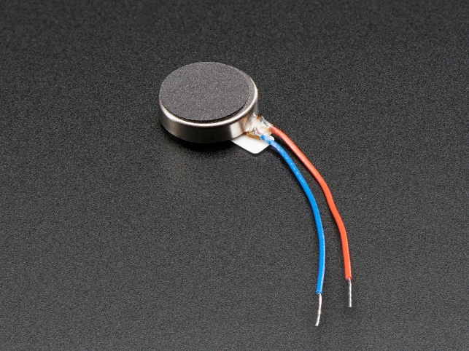
- HARDWARE: Components and Parts
-Vibrating Motors: Two wires are used to control/power the vibe. Simply provide power from a battery or microcontroller pin (red is positive, blue is negative) and it will buzz away. The rated voltage is 2.5 to 3.8V and for many projects, we found it vibrates from 2V up to 5V, higher voltages result in more current draw but also a stronger vibration.
The HeadBand: We chose this material to make the headband because of its comfortable and Suitable material for headband. We needed material that can hold of printed plastic fibre structure and motors elastic bands and then easily stitch the fabric into the head band. This material also has a good aesthetic Profile.

Slide 13
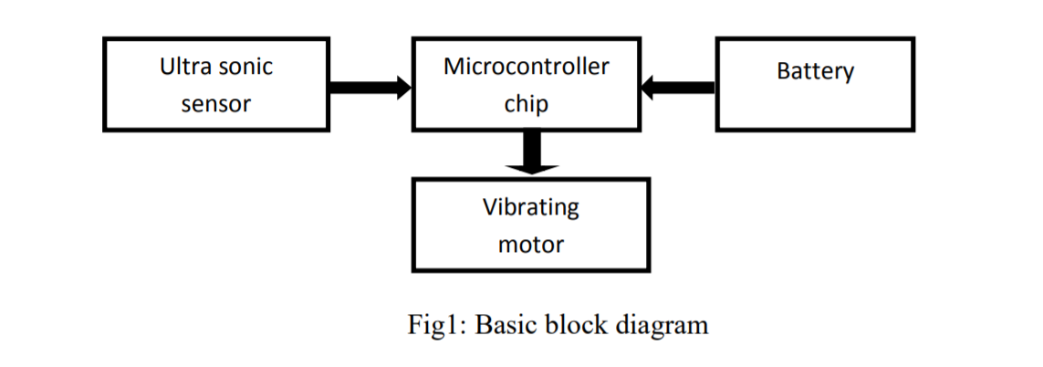
- HARDWARE DESIGN

Slide 14
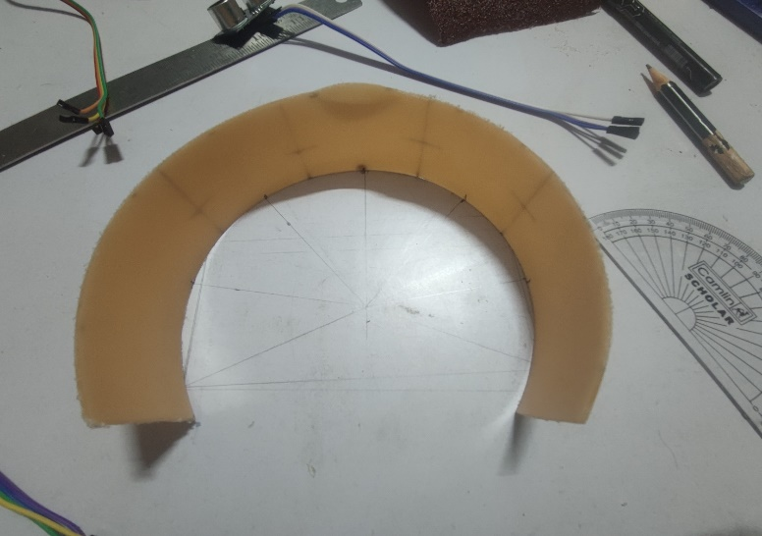
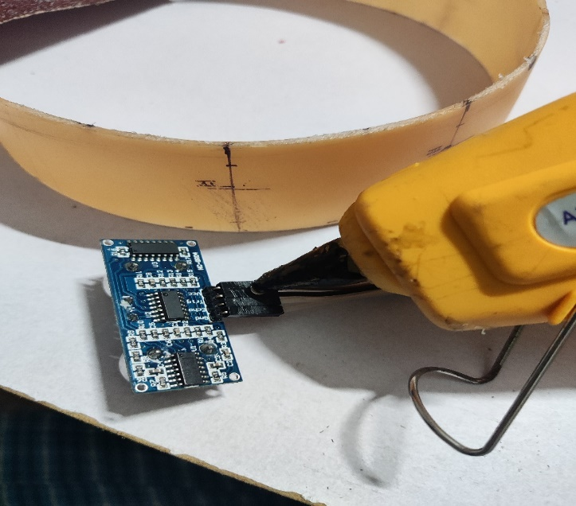
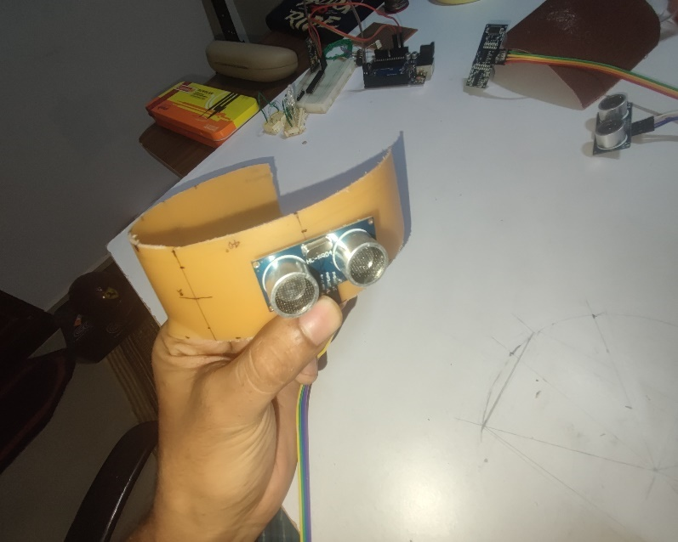
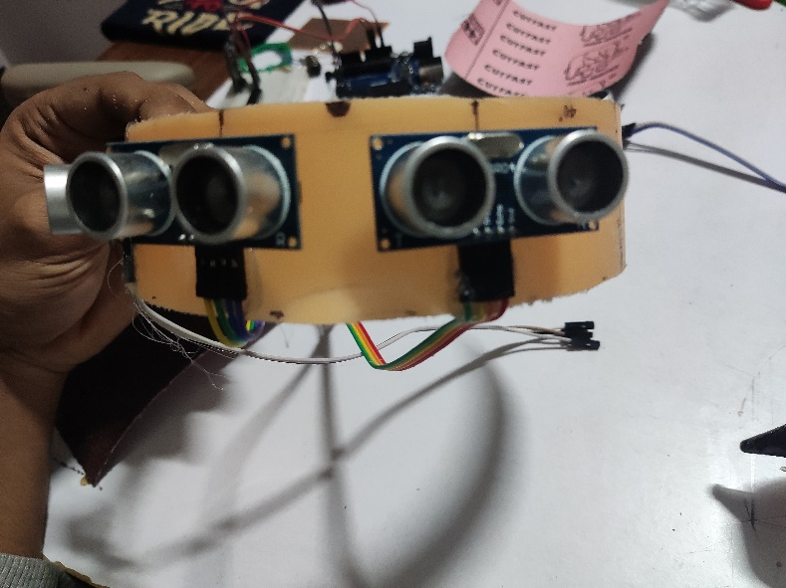
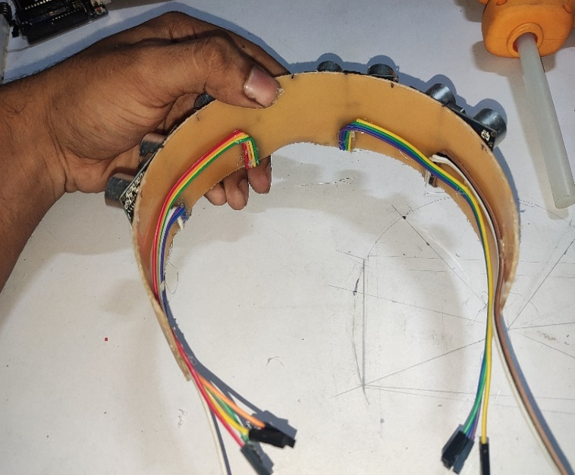
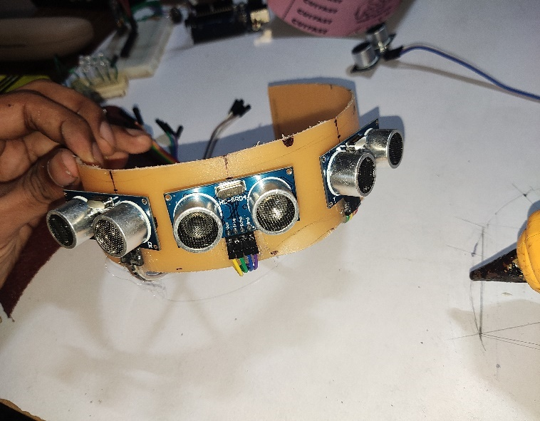
- Construction:
1: VISION CROWN

Slide 15
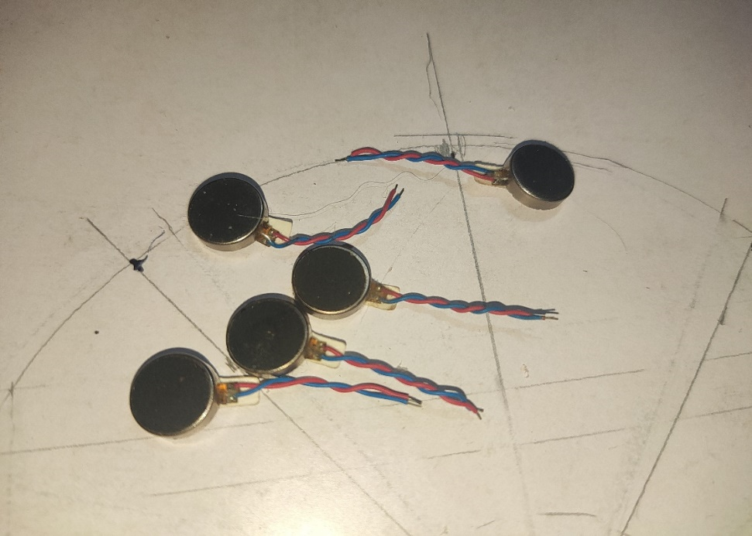
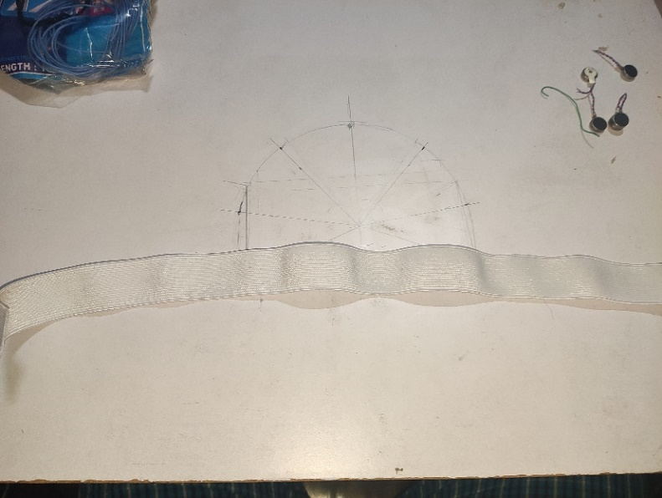
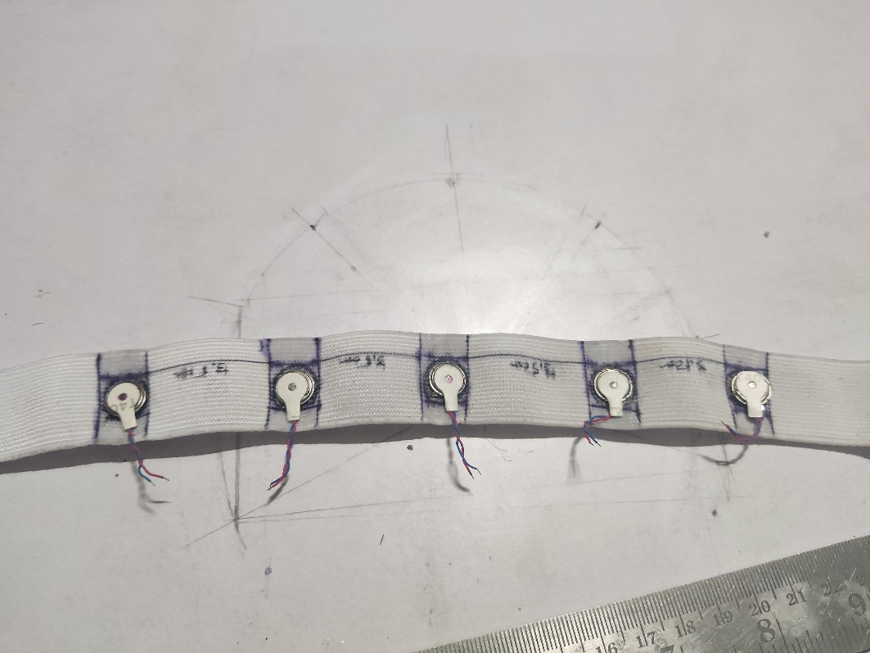
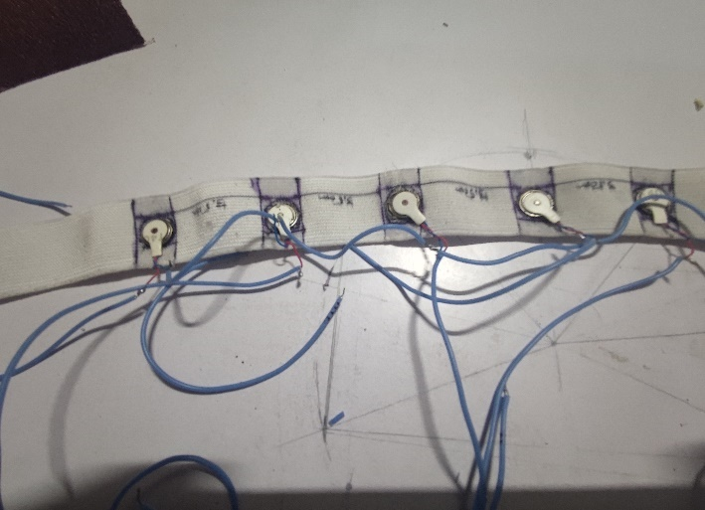
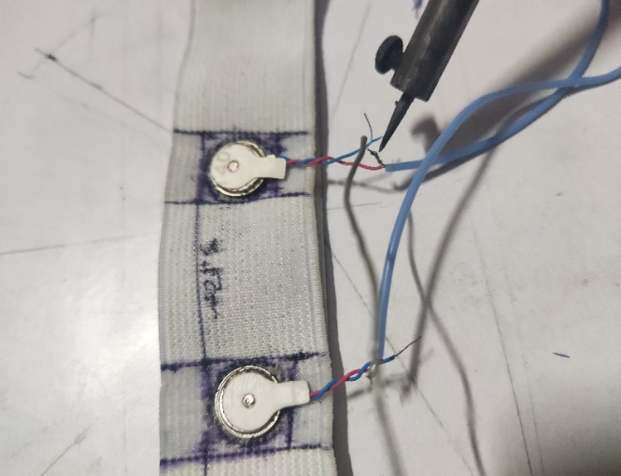
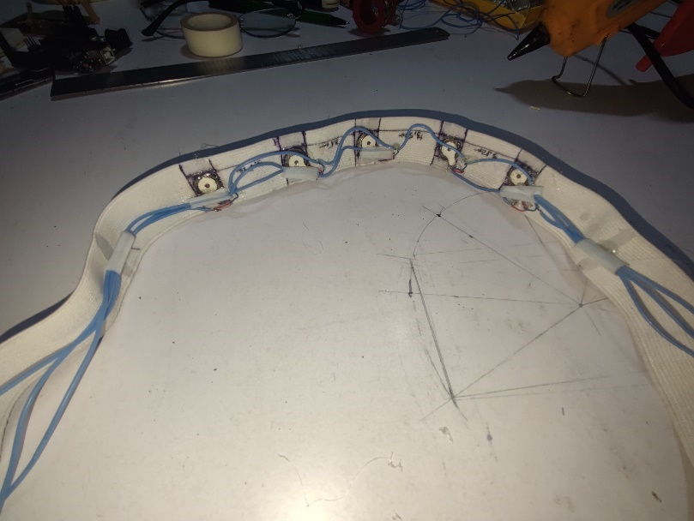
- Construction:
2. HAPTIC BAND:

Slide 16
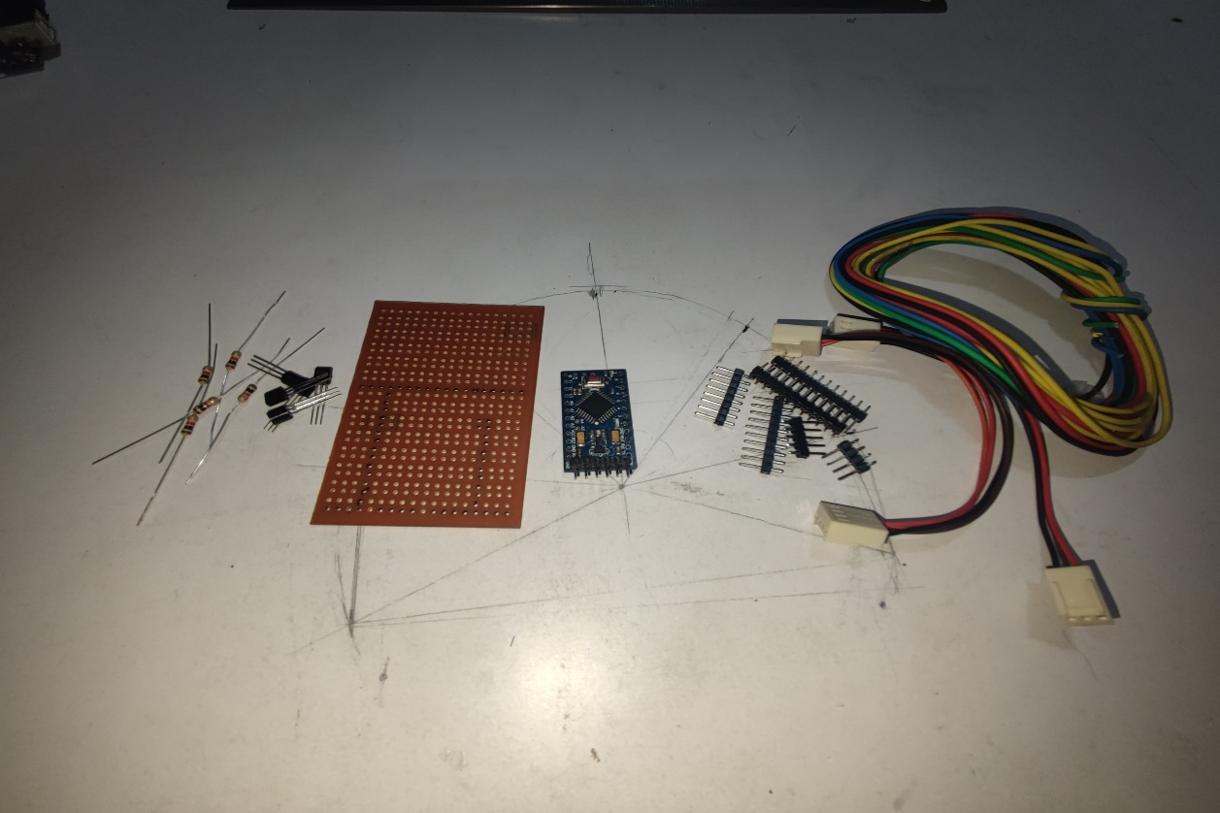
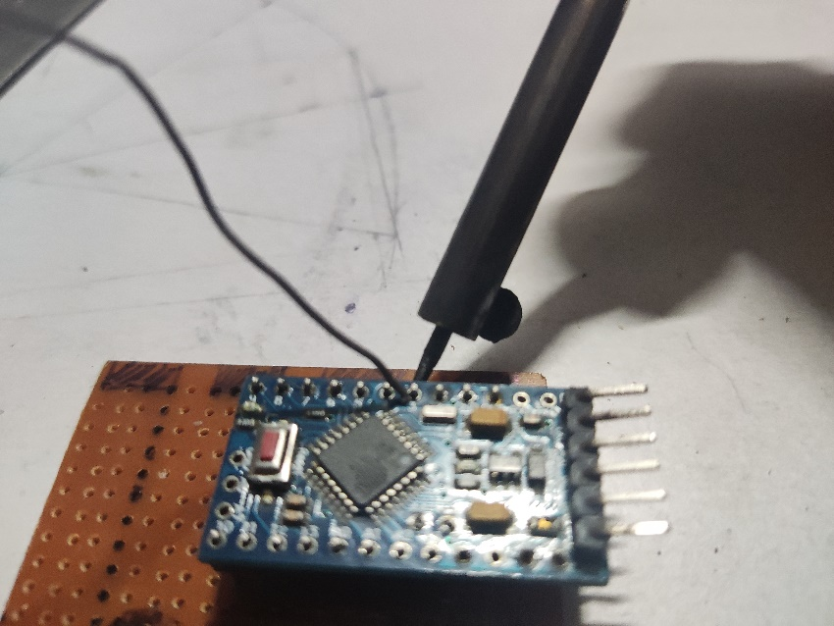
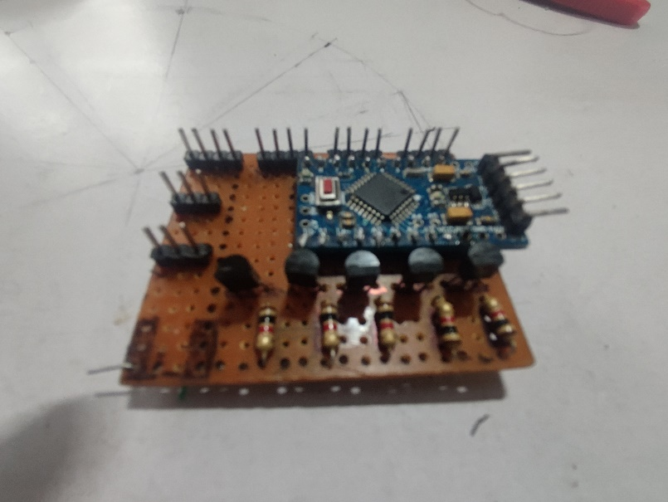
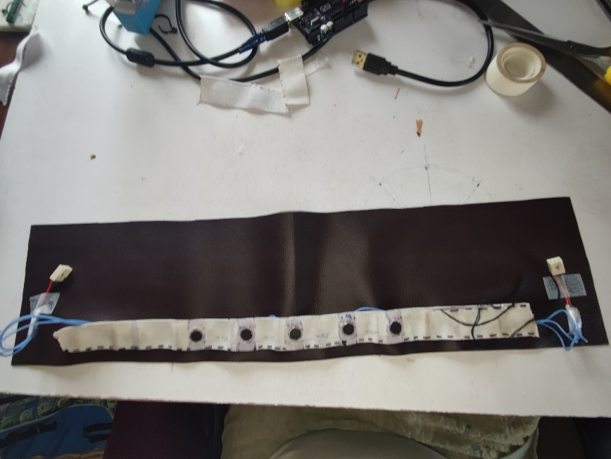
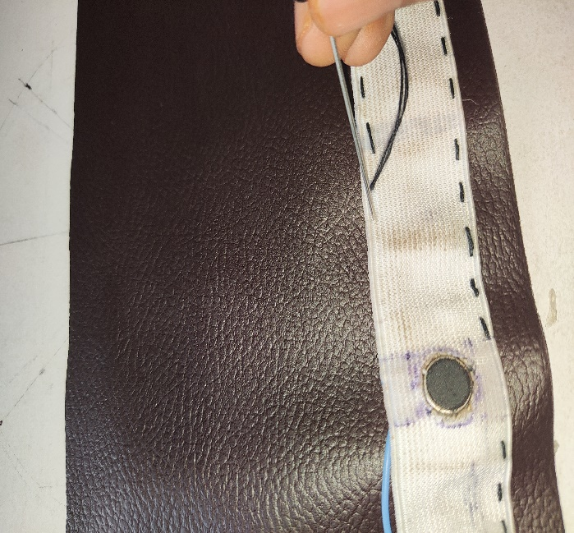
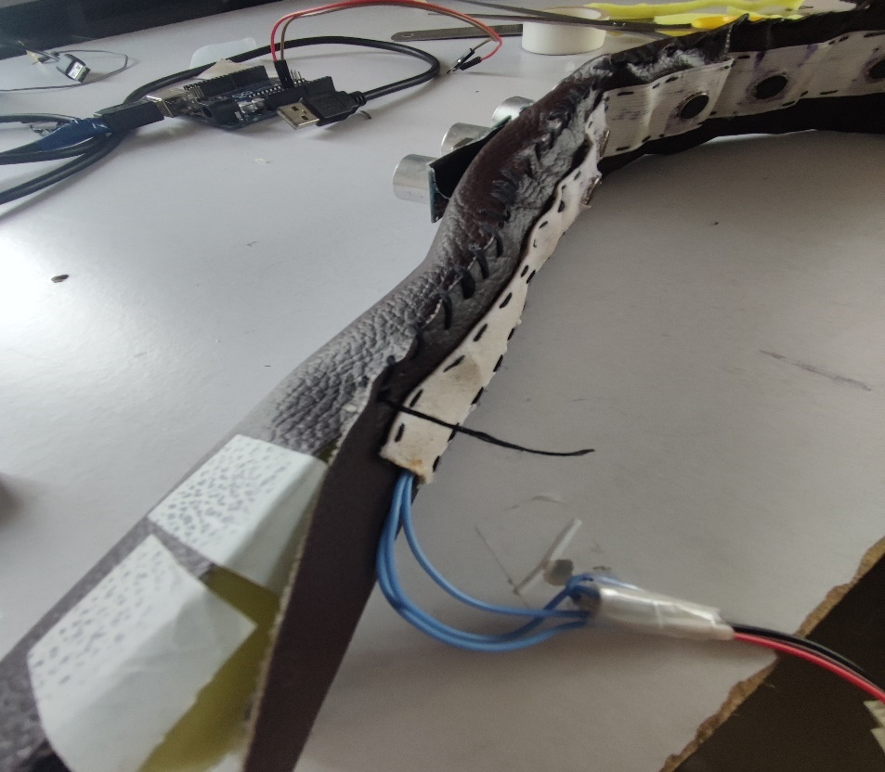
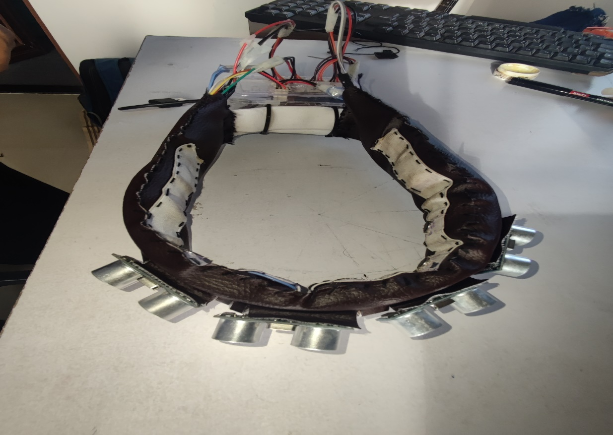
- Construction:
-CONTROLLER & HEADBAND

Slide 17
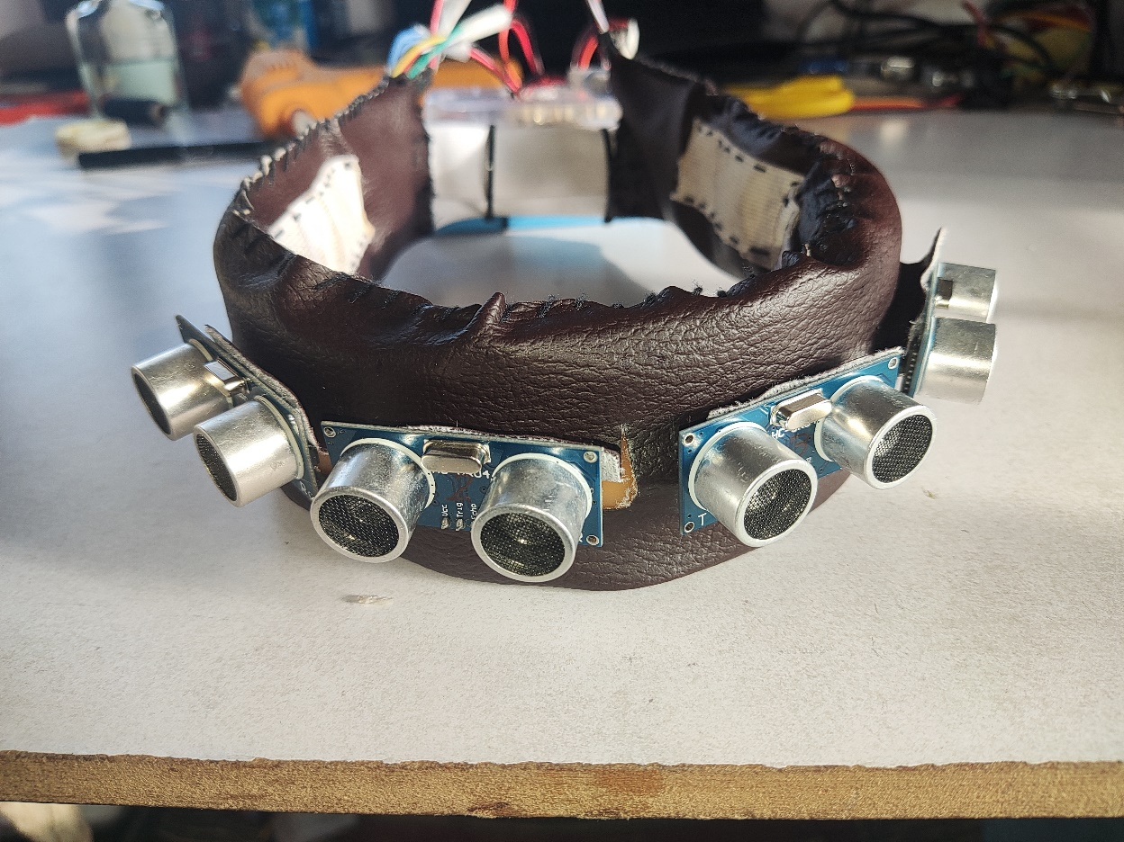
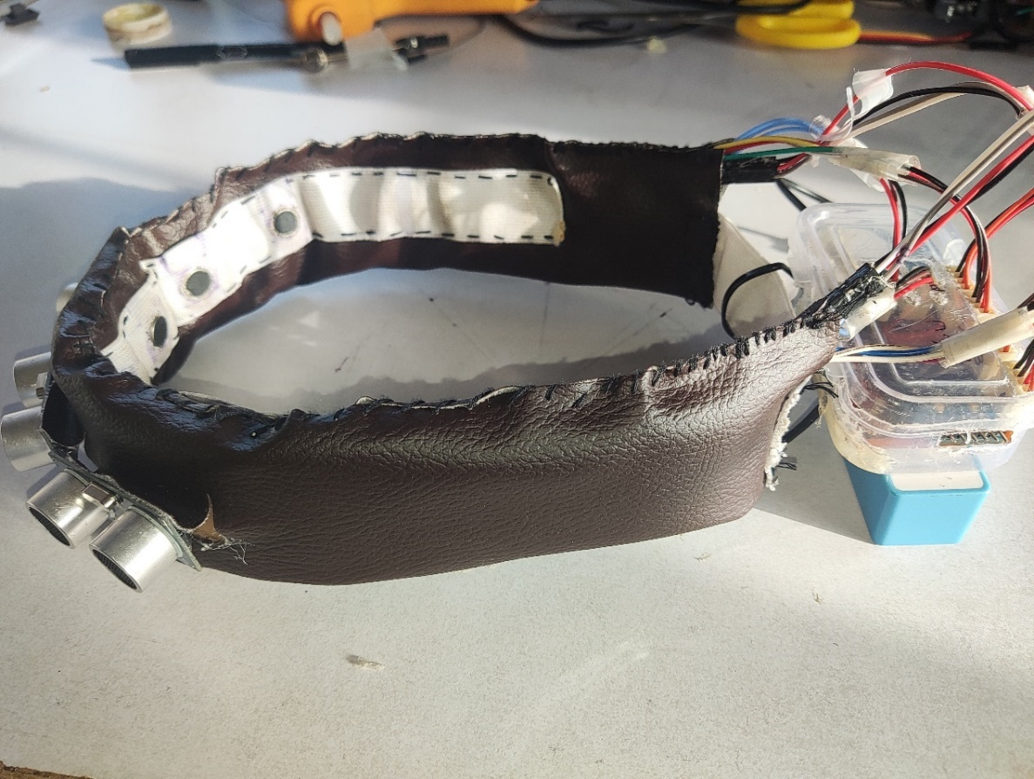
- CONCLUSION
- The aim of this work is to provide anyone in need for a hands-free Navigation System with an inexpensive, full-featured walking. Particularly, it is addressed to special needs people so that they could have access to the modern world technologies just as average people.
The proposed Head Mounted, Sonar-based, Navigation has been designed to be like any other wearable device, ready to use with any application on any platform. The system was seen to be more effective and cost efficient than existing tech.

Slide 18
ADVANTAGES
The use of this Band helps the people with special needs to walk without the use of hand and it is cost effective.
A potential wearable technology for lazy people who do not wish to use hands.
It can be used for old people with poor vision.
It is wearable, and easily removed, without causing any complications.
It can gives more RESPONSE TIME for the user to act.
It can used in multiple operating enviroments.
Disadvantages:
Need a lot of more research and development.

Slide 19
FUTURE SCOPE
This system could further developed to support different environment conditions like indoors, offices, more varying patterns and improve the detection for different objects using computer vision. With more patterns variance the device could be more universal.
APPLICATION
The Headband systems could be upgraded to further application like other works apart from navigations like Sports, or reading, Gaming and applications where haptic feedback vision could be applied and used to aid Blind people.
The Headbands can also be applied for entertainment industries for normal humans to enhance user experience by using haptic feedback as additional sensory.

Slide 20
THANKYOUU

